Slide 1
Do not touch face CAP and temperature detection system
TEAM NAME : LACHIT
TEAM No. :12
Team members : 1. Akash Chetia
2. Reckon Mazumdar
3. Kunjal Sarma

Slide 2
CONTENTS
Objective.
Significance of project.
Our approach.
Working.
Methodology.
Project Requirements and estimated cost.
Existing solution Vs our solution.
Show stoppers.
Conclusion.

Slide 3
Objective
The threat of coronavirus disease caused by a novel coronavirus SARS-Cov2 is becoming a life-threatening situation across the globe. So our main objective is to implement a system that will help and ensure the authority and every individual to get early live updates and warnings of the possible COVID-19 victim and the places vulnerable to the contracting virus. Also to prevent people to touch their faces which will keep a check on the people getting infected due to the virus.

Slide 4
Significance of project
The following are the benefits listed as follows:
Ensures safety from suspected Covid-19 victims.
Stores live data (body temperature and location) on the cloud.
Helps to keep track of the suspected covid-19 cases.
Prevents the bad practice of touching face as it is against the health recommendation.
Capability to give early warning of abnormal body temperature to the nearby person in contact.
It will be a cost-effective and efficient solution.

Slide 5
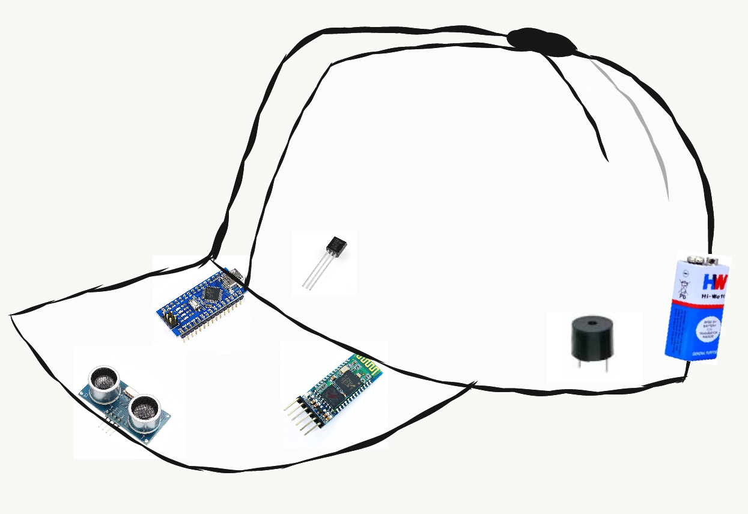
Our approach
As we all know that fever is a major symptom of Covid -19 .So our idea is based on the application of temperature sensor to collect temperature data of the body and detect suspected covid-19 patients. It will also prevent the bad practice of touching face frequently with the help of UV sensor.
Temperature sensor
Buzzer
Battery
COVID – 19 prevention CAP
It will help the user to maintain a good habit of not touching the face
It will alert the user for covid suspected person near him/her.
UV Sensor
Arduino
BT Module

Slide 6
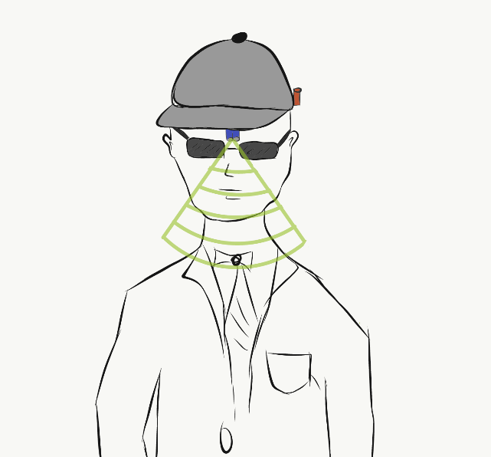
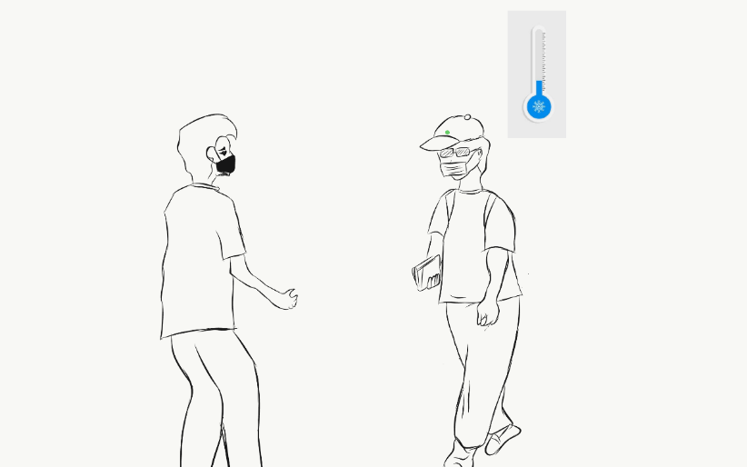
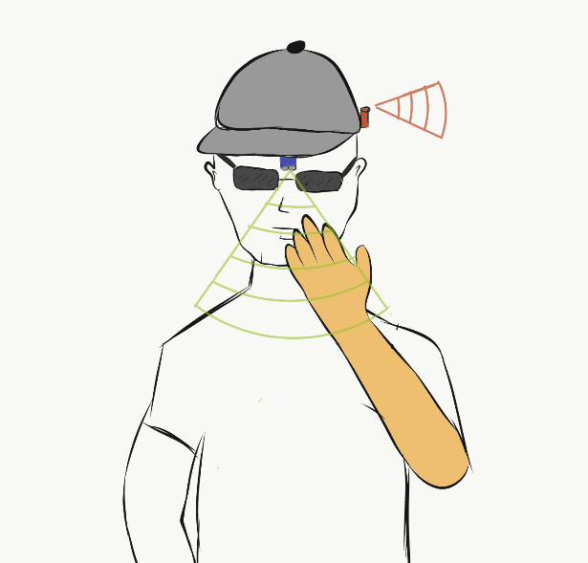
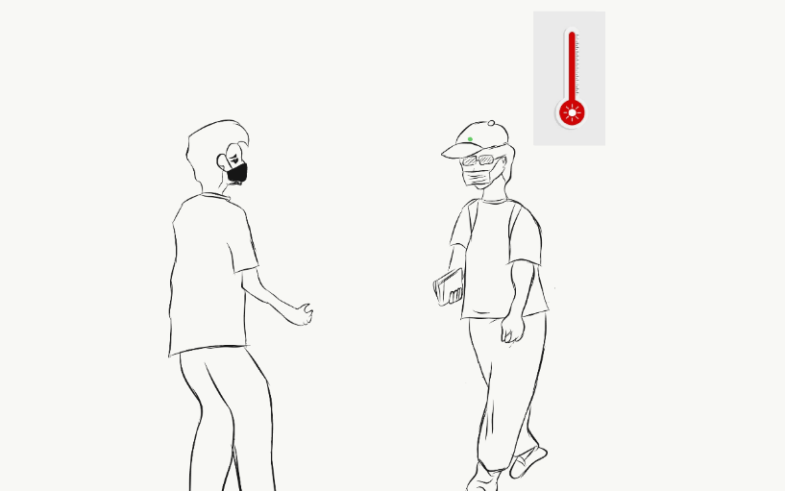
working
Covid suspected Tracing/detection system
Do not touch face system
Everything OK✔
Normal body temperature
No hand detected
Everything OK ✅
Warning
Suspected covid-19 case
Body temperature above 38 °C
Hand detected !!!
Buzzer activated ✗

Slide 7
Methodology:
The project will be based on the integration of both software and hardware components. The system will function with the help of a temperature sensor, BT Module, and a mobile application (android/iOS). It is divided into two parts which are as follows :
Do not touch the face system - This system will function with the help of a UV-sensor, a buzzer, and Arduino.
Body Temperature detection system to keep track of possible COVID-19 cases - The system will function with the help of a temperature sensor, BT Module, Arduino, and a mobile application (android/iOS).
Hand Detected
U.V sensor
Arduino
Alarms Buzzer
Abnormal Temperature
Temperature
Sensor data collected
Data send to mobile app via BT module and arduino.
Mobile application stores the temperature data and users GPS location Data on cloud.
The same data is used to warn other users and helps them to take preventive measures.

Slide 8
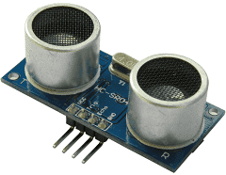
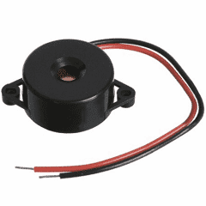
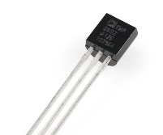
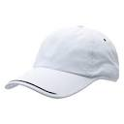
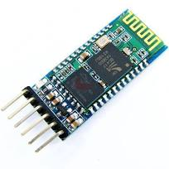
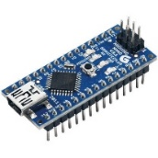
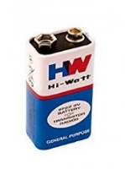
Project Requirements
HC-SR04 ultrasonic sensor
Buzzer
Temperature sensor (TMP 36)
CAP
HC-05 Bluetooth Module
Arduino
9V Battery
Android app
Cloud data hosting
Estimated project cost : ₹500 - ₹900

Slide 9
Existing solution Vs our solution:
The most common solution to track covid-19 patients is the Arogya Setu app. But the app requires
the user to provide their data manually, but our solution is more optimized and automatic.
Show stoppers
The device should be handled carefully.
It only gives the data of suspected covid cases not confirmed covid cases.
Conclusion
Thus we conclude that our do not touch face cap and temperature detection system is affordable, effective and an easy to use solution for everyone to maintain proper social distancing and to maintain the good habit of not touching the face during this corona pandemic.

